Slide 1
Hashing and digital 33 signature
Alisha Razzaq BSCS 8th Semester

Slide 2
Hashing and digital 33 signature
Hashing is the process of transforming any given key or a string of characters into another value

Slide 3
This is usually represented by a shorter, fixed –length value or key that represents and makes it easier to find or employ the original string.
The most popular use of hashing is the implementation of Hash Table.
In this techniques , symmetric key Cryptography is used because both sender and receiver use the same key to encrypt and decrypt the message.
VALUE KEYS | INDEX
125 | 0
258 | 1
147 | 2
589 | 3
3681 | 4
0014 | 5

Slide 4
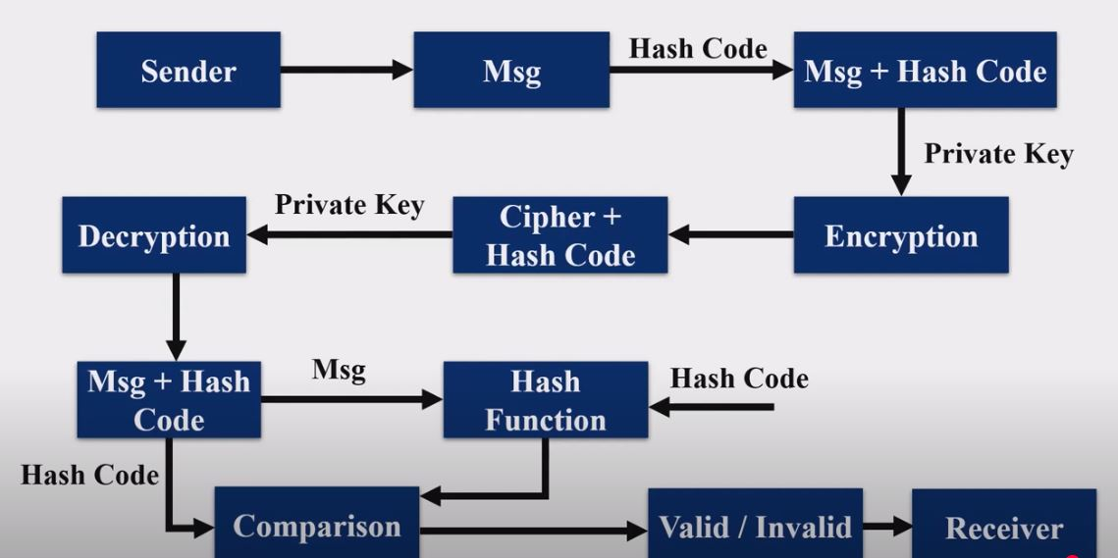

Slide 5
Features
Fixed length output
Compression function
Digest(Smaller representation of larger data)

Slide 6
Properties
Deterministic:-Same input yields same output.
Non-invertible:-Cannot retrieve original input from output.
Fixed-size output:-Regardless of input size.

Slide 7
Digital 33 signature
A digital signature is a cryptography output used to verify the authenticity of data.

Slide 8
A digital signature algorithm allows for two distinct operations.
A signing operation , which uses a signing key to produce a signature over raw data.
A verification operation , which the signature can be validated by a party who has no knowledge of the signing key.

Slide 9
The main purpose of a digital signature are:
Verification of the integrity of the signed data.
Non-repudiation if the signer claims the signature is not authentic.
In this technique, sender send the message with key and signature as well.
Asymmetric key cryptography is used because both sender and receiver use different keys to encrypt and decrypt msg.
Receiver receive the msg and decrypt it with it’s own private key and verify by using algorithm either sender is valid or not.

Slide 10
S
Message
Mes + Signature
Private Key
Digital Signature Algorithm
Signature
Verification by Digital Signature Algorithm
Valid/invalid
Private Key

